Slide 1
Topic A: Space, time and motion A.2.1 – Forces…
Guiding questions
How can forces acting on a system be represented both visually and algebraically?
How can Newton’s laws be modelled mathematically?
How can knowledge of forces and momentum be used to predict the behaviour of interacting bodies?
Notes:
© 2006 By Timothy K. Lund

Slide 2
Topic A: Space, time and motion A.2.1 – Forces…
Students should understand:
•Newton’s three laws of motion
•forces as interactions between bodies
•that forces acting on a body can be represented in a free-body diagram
•that free-body diagrams can be analysed to find the resultant force on a system
•the nature and use of the following contact forces… (Hooke’s Law in A.3)
•the nature and use of the following field forces… (will cover these in D.1 and D.2)
Notes:
‹#›
© 2006 By Timothy K. Lund

Slide 3
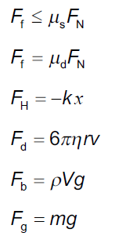
Topic A: Space, time and motion A.2.1 – Forces…
Data booklet reference:
Notes:
‹#›
© 2006 By Timothy K. Lund

Slide 4
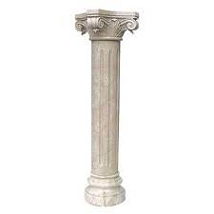
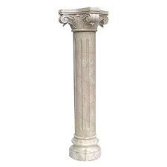
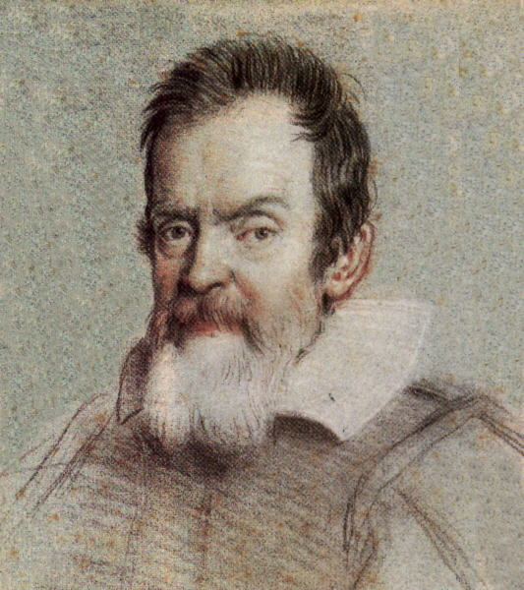

Topic A: Space, time and motion A.2.1 – Forces…
Newton’s laws of motion
∙Mechanics is the branch of physics which concerns itself with forces, and how they affect a body's motion.
∙Kinematics is the sub-branch of mechanics which studies only a body's motion without regard to causes.
∙Dynamics is the sub-branch of mechanics which studies the forces which cause a body's motion.
The two pillars of mechanics
Kinematics
Dynamics
Galileo
Topic A.1
Topic A.2
Newton
Notes:
© 2006 By Timothy K. Lund

Slide 5


Topic A: Space, time and motion A.2.1 – Forces…
Forces as interactions between bodies
∙A force is a push or a pull measured in Newtons.
∙One force we are very familiar with is the force of gravity, AKA the weight.
∙The very concepts of push and pull imply direction. Thus forces are vectors.
∙The direction of the weight is down toward the center of the earth.
∙If you have a weight of 600 Newtons (or 600 N), your weight can be expressed as a vector: 600 N, down.
∙We will show later that weight has the formula
F_{g} = mg
where g = 10 m s ⁻²
weight
and m is the mass in kg
Notes:
© 2006 By Timothy K. Lund

Slide 6
Topic A: Space, time and motion A.2.1 – Forces…
Free-body diagrams
F_{g} = mg
where g = 10 m s ⁻²
weight
and m is the mass in kg
EXAMPLE: Calculate the weight of a 25-kg object.
SOLUTION:
Since m = 25 kg and g = 10 m s⁻²,
F_{g} = mg = (25)(10) = 250 N
Note that W inherits its direction from the fact that g points downward.
We sketch the mass as a point particle (dot), and the weight as a vector in a free-body diagram:
Free-body diagram
mass
force
F_{g}
Notes:
© 2006 By Timothy K. Lund

Slide 7

Topic A: Space, time and motion A.2.1 – Forces…
Free-body diagrams
∙Certainly there are other forces besides weight that you are familiar with.
∙For example, when you set a mass on a tabletop, even though it stops moving, it still has a weight.
∙The implication is that the tabletop applies a counterforce to the weight, called a normal force.
∙Note that the weight and the normal forces are the same length – they balance.
∙The normal force is called a surface contact force.
F_{N}
F_{g}
FYI ∙The normal force is often called (unwisely) the reaction force – thus sometimes is it is designated R or F_{R} (not in IB).
Notes:
© 2006 By Timothy K. Lund

Slide 8
Topic A: Space, time and motion A.2.1 – Forces…
The nature and use of the following contact forces
∙Tension F_{T} can only be a pull and never a push.
∙Friction F_{f} tries to oppose the motion.
∙Friction F_{f} is parallel to the contact surface.
∙Normal F_{N} is perpendicular to the contact surface.
∙Friction and normal are mutually perpendicular. F_{f} ⊥ F_{N}.
∙Friction and normal are surface contact forces.
∙Weight F_{g} is an action-at-a-distance force.
F_{N}
F_{T}
F_{f}
the tension
Contact surface
F_{g}
Notes:
© 2006 By Timothy K. Lund

Slide 9
Topic A: Space, time and motion A.2.1 – Forces…
Free-body diagrams
∙Weight is sketched from the center of an object.
∙Normal is always sketched perpendicular to the contact surface.
∙Friction is sketched parallel to the contact surface.
∙Tension is sketched at whatever angle is given.
F_{T}
F_{N}
F_{f}
F_{g}
Notes:
© 2006 By Timothy K. Lund

Slide 10
Topic A: Space, time and motion A.2.1 – Forces…
Free-body diagrams
EXAMPLE: An object has a tension acting on it at 30° as shown. Sketch in the forces, and draw a free-body diagram.
SOLUTION:
Weight is drawn from the center, down.
Normal is drawn perpendicular to the surface from the surface.
Friction is drawn par- allel to the surface.
F_{N}
F_{T}
F_{f}
Free-body diagram
30°
F_{T}
F_{N}
30°
F_{f}
F_{g}
F_{g}
Notes:
© 2006 By Timothy K. Lund

Slide 11
Topic A: Space, time and motion A.2.1 – Forces…
FBDs and the resultant force on a system
∙The resultant (or net) force (F_{net}) is just the vector sum of all of the forces acting on a body.
EXAMPLE: An object has mass of 25 kg. A tension of 50 N and a friction force of 30 N are acting on it as shown. What is the resultant force?
SOLUTION:
Since the weight and the normal forces cancel out in the y-direction, we only need to worry about the forces in the x-direction.
The net force is thus
50 – 30 = 20 N (+x-dir).
F_{N}
50 N
F_{f}
F_{T}
30 N
F_{g}
Notes:
© 2006 By Timothy K. Lund

Slide 12
Topic A: Space, time and motion A.2.1 – Forces…
FBDs and the resultant force on a system
∙The resultant (or net) force (F_{net}) is just the vector sum of all of the forces acting on a body.
F_{net} = ΣF
F_{x,net} = ΣF_{x}
F_{y,net} = ΣF_{y}
net force
EXAMPLE: An object has exactly two forces F₁ = 50. N and F₂ = 30. N applied simultaneously to it. What is the resultant force’s magnitude?
F₂
SOLUTION:
F_{net} = ΣF = F₁ + F₂ so we simply graphically add the two vectors:
The magnitude is given by
F_{net}² = 50² + 30²
F_{net} = 58 N.
F_{net}
30. N
50. N
F₁
Notes:
© 2006 By Timothy K. Lund

Slide 13
Topic A: Space, time and motion A.2.1 – Forces…
FBDs and the resultant force on a system
∙The resultant (or net) force (F_{net}) is just the vector sum of all of the forces acting on a body.
F_{net} = ΣF
F_{x,net} = ΣF_{x}
F_{y,net} = ΣF_{y}
net force
EXAMPLE: An object has exactly two forces F₁ = 50. N and F₂ = 30. N applied simultaneously to it as shown. What is the resultant force’s direction?
SOLUTION:
Direction is measured from the (+) x-axis.
Opposite and adjacent are given directly, so use tangent.
tan θ = opp / adj = 30 / 50 = 0.6
θ = tan⁻¹(0.6) = 31°.
F₂
F_{net}
30. N
θ
50. N
F₁
Notes:
© 2006 By Timothy K. Lund

Slide 14
Topic A: Space, time and motion A.2.1 – Forces…
FBDs and the resultant force on a system
EXAMPLE: An object has exactly two forces F₁ = 50. N and F₂ = 30. N applied simultaneously to it. What is the resultant force’s magnitude?
SOLUTION:
Begin by resolving F₁ into its x- and y-components.
Then F_{net,x} = 44 N and
F_{net,y} = 23 + 30 = 53 N.
F_{net}² = F_{net,x}² + F_{net,y}²
F_{net}² = 44² + 53²
F_{net} = 69 N.
F₂
30. N
F₁
50. N
50 sin 28°
23 N
28°
44 N
50 cos 28°
Notes:
© 2006 By Timothy K. Lund

Slide 15
Topic A: Space, time and motion A.2.1 – Forces…
Surface frictional force
∙Recall that friction acts opposite to the intended direction of motion, and parallel to the contact surface.
∙Suppose we begin to pull a crate to the right, with gradually increasing force.
∙We plot the applied force, and the friction force, as functions of time:
tension
static
friction
dynamic
friction
friction
Force
F_{T}
F_{T}
F_{T}
F_{T}
F_{T}
F_{f}
F_{f}
F_{f}
F_{f}
F_{f}
Time
static
dynamic
Notes:
© 2006 By Timothy K. Lund

Slide 16
Topic A: Space, time and motion A.2 – Forces…
F_{s,max}
Surface frictional force
∙During the static phase, the static friction force F_{s} exactly matches the applied (tension) force.
∙F_{s} increases linearly until it reaches a maximum value F_{s,max}.
∙The friction force then almost instantaneously decreases to a constant value F_{d}, called the dynamic friction force.
∙Take note of the following general properties of the friction force:
Force
tension
F_{d}
friction
static
Time
dynamic
0 ≤ F_{s} ≤ F_{s,max}
F_{d} < F_{s,max}
F_{d} = a constant
Notes:
© 2006 By Timothy K. Lund

Slide 17
Topic A: Space, time and motion A.2 – Forces…
Surface frictional force
∙So, what exactly causes friction?
∙People in the manufacturing sector who work with metals know that the more you smoothen and polish two metal surfaces, the more strongly they stick together if brought in contact.
∙In fact, if suitably polished in a vacuum, they will stick so hard that they cannot be separated.
∙We say that the two pieces of metal have been cold-welded.
Notes:
© 2006 By Timothy K. Lund

Slide 18
Topic A: Space, time and motion A.2 – Forces…
Surface frictional force
∙At the atomic level, when two surfaces come into contact, small peaks on one surface cold weld with small peaks on the other surface.
∙Applying the initial sideways force, all of the cold welds oppose the motion.
∙If the force is sufficiently large, the cold welds break, and new peaks contact each other and cold weld.
∙If the surfaces remain in relative sliding motion, fewer welds have a chance to form.
∙We define the unitless constant, called the coefficient of friction μ, which depends on the composition of the two surfaces, as the ratio of F_{f} / F_{N}.
surface 1
surface 1
surface 1
surface 2
surface 2
surface 2
cold welds
Notes:
© 2006 By Timothy K. Lund

Slide 19
Topic A: Space, time and motion A.2 – Forces…
Surface frictional force
∙Since there are two types of friction, static and dynamic, every pair of materials will have two coefficients of friction, μ_{s} and μ_{d}.
∙In addition to the "roughness" or "smoothness" of the materials, the friction force depends, not surprisingly, on the normal force F_{N}.
∙The harder the two surfaces are squished together (this is what the normal force measures) the more cold welds can form.
∙Here are the relationships between the friction force F_{f}, the coefficients of friction μ, and the normal force F_{N}:
F_{f} ≤ μ_{s} F_{N}
F_{f} = μ_{d} F_{N}
dynamic
friction
static
Notes:
© 2006 By Timothy K. Lund

Slide 20

Topic A: Space, time and motion A.2 – Forces…
y
F_{N}
F_{f}
Surface frictional force
x
F_{g}
15°
EXAMPLE: A piece of wood with a coin on it is raised on one end until the coin just begins to slip. The angle the wood makes with the horizontal is θ = 15°. What is the coefficient of static friction?
∙Thus the coefficient of static friction between the metal of the coin and the wood of the plank is 0.268.
FBD, coin
θ = 15°
∑F_{y} = 0
∑F_{x} = 0
F_{N} – mg cos 15° = 0
F_{f} – mg sin 15° = 0
F_{N} = mg cos 15°
F_{f} = mg sin 15°
F_{f} = μ_{s} F_{N}
μ_{s} =
mg sin 15°
mg cos 15°
= tan 15°
mg sin 15° = μ_{s} mg cos 15°
= 0.268
Notes:
© 2006 By Timothy K. Lund

Slide 21
Topic A: Space, time and motion A.2 – Forces…
y
F_{N}
F_{f}
Surface frictional force
x
F_{g}
12°
EXAMPLE: Now suppose the plank of wood is long enough so that you can lower it to the point that the coin keeps slipping, but no longer accelerates (v = const, a = 0). If this new angle is 12°, what is the coefficient of dynamic friction?
∙Thus the coefficient of dynamic friction between the metal of the coin and the wood of the plank is 0.213.
FBD, coin
θ = 12°
∑F_{y} = 0
∑F_{x} = 0
F_{N} – mg cos 12° = 0
F_{f} – mg sin 12° = 0
F_{N} = mg cos 12°
F_{f} = mg sin 12°
F_{f} = μ_{d} F_{N}
⇒ μ_{d} = tan 12°
= 0.213
mg sin 12° = μ_{d} mg cos 12°
Notes:
© 2006 By Timothy K. Lund

Slide 22
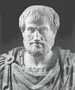

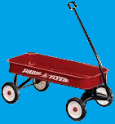

Topic A: Space, time and motion A.2 – Forces…
Newton’s laws of motion – The first law
∙Newton’s first law is related to certain studies made by Galileo Galilee which contradicted Aristotelian tenets.
∙Aristotle basically said “The natural state of motion of all objects (but the heavenly ones) is one of rest.”
∙A child will learn that if you stop pushing a wagon, the wagon will eventually stop moving.
∙This simple observation will lead the child to come up with a force law that looks something like this:
“In order for a body to be in motion, there must be a force acting on it.”
∙As we will show on the next slide, both of these observations are false!
FALSE
FALSE
Notes:
© 2006 By Timothy K. Lund

Slide 23


Topic A: Space, time and motion A.2 – Forces…
Inertia will only change if there is a force.
Newton’s laws of motion – The first law
∙Here’s how Galileo (1564-1642) thought:
∙If I give a cart a push on a smooth, level surface, it will eventually stop.
∙What can I do to increase the distance it rolls without pushing it harder or changing the slope?
∙If I can minimize the friction, it’ll go farther.
∙In fact, he reasoned, if I eliminate the friction altogether the cart will roll forever!
∙Galileo called the tendency of an object to not change its state of motion inertia.
Notes:
© 2006 By Timothy K. Lund

Slide 24

Topic A: Space, time and motion A.2 – Forces…
A body’s velocity will only change if there is a net force acting on it.
Describing the consequences of Newton’s first law for translational equilibrium
∙Newton’s first law is drawn from his concept of net force and Galileo’s concept of inertia.
∙Newton’s first law says that the velocity of an object will not change if there is no net force acting on it.
∙In his words...“Every body continues in its state of rest, or of uniform motion in a straight line, unless it is compelled to change that state by forces impressed thereon.”
∙In symbols...
∙ΣF = 0 is the condition for translational equilibrium.
v = 0
v = CONST
ΣF
If ΣF = 0,
then v = CONST.
Newton’s first law
Notes:
© 2006 By Timothy K. Lund

Slide 25
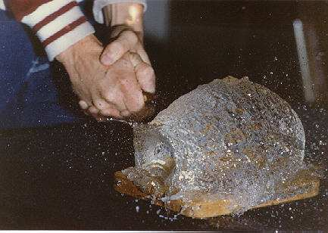
Topic A: Space, time and motion A.2 – Forces…
Translational equilibrium
∙As a memorable demonstration of inertia – matter’s tendency to not change its state of motion (or its state of rest) - consider this:
∙A water balloon is cut very rapidly with a knife.
∙For an instant the water remains at rest!
∙Don’t try this at home, kids.
Notes:
© 2006 By Timothy K. Lund

Slide 26
Topic A: Space, time and motion A.2 – Forces…
30°
45°
F_{T2}
F_{T1}
knot
F_{T3}
m
Translational equilibrium
EXAMPLE: An object of mass m is hanging via three cords as shown. Find the tension in each of the three cords, in terms of m.
SOLUTION:
Give each tension a name to organize your effort.
Draw a free body diagram of the mass and the knot.
T₃ is the easiest force to find. Why?
Since m is not moving, its FBD tells us that
ΣF_{y} = 0 or F_{T3} – F_{g} = 0 or F_{g} = F_{T3} = mg .
F_{T3}
F_{g}
FBD, m
F_{T1}
F_{T2}
30°
45°
F_{T3}
FBD, knot
Notes:
© 2006 By Timothy K. Lund

Slide 27
Topic A: Space, time and motion A.2 – Forces…
30°
45°
F_{T2}
F_{T1}
knot
F_{T3}
m
Translational equilibrium
EXAMPLE: An object of mass m is hanging via three cords as shown. Find the tension in each of the three cords, in terms of m.
SOLUTION: F_{T3} = mg
Now we break T₁ and T₂ down to components.
Looking at the FBD of the knot we see that
F_{T1x} = F_{T1} cos 30° = 0.866F_{T1}
F_{T1y} = F_{T1} sin 30° = 0.500F_{T1}
F_{T2x} = F_{T2} cos 45° = 0.707F_{T2}
F_{T2y} = F_{T2} sin 45° = 0.707F_{T2}
F_{T3}
F_{g}
FBD, m
F_{T1}
F_{T2}
30°
45°
F_{T3}
FBD, knot
Notes:
© 2006 By Timothy K. Lund

Slide 28
Topic A: Space, time and motion A.2 – Forces…
30°
45°
F_{T2}
F_{T1}
knot
F_{T3}
m
Translational equilibrium
EXAMPLE: An object of mass m is hanging via three cords as shown. Find the tension in each of the three cords, in terms of m.
SOLUTION: F_{T3} = mg
F_{T3}
∑F_{x} = 0
F_{g}
0.707F_{T2} - 0.866F_{T1} = 0
FBD, m
F_{T2} = 1.225F_{T1}
∑F_{y} = 0
F_{T1}
F_{T2}
0.707F_{T2} + 0.500F_{T1} - F_{T3} = 0
0.707(1.225F_{T1}) + 0.500F_{T1} = F_{T3}
30°
45°
F_{T1} = mg / 1.366
F_{T3}
F_{T2} = 1.225(mg / 1.366)
F_{T2} = 0.897mg
FBD, knot
Notes:
© 2006 By Timothy K. Lund

Slide 29
Topic A: Space, time and motion A.2 – Forces…
30°
45°
F_{T2}
F_{T1}
knot
F_{T3}
m
Solving problems involving forces and resultant force
PRACTICE: A 25-kg mass is hanging via three cords as shown. Find the tension in each of the three cords, in Newtons.
SOLUTION:
Since all of the angles are the same use the formulas we just derived:
F_{T3} = mg = 25(10) = 250 N
F_{T1} = mg / 1.366 = 25(10) / 1.366 = 180 N
F_{T2} = 0.897mg = 0.897(25)(10) = 220 N
FYI ∙This was an example of using Newton’s first law with v = 0. The next example shows how to use Newton’s first law when v is constant, but not zero.
Notes:
© 2006 By Timothy K. Lund

Slide 30
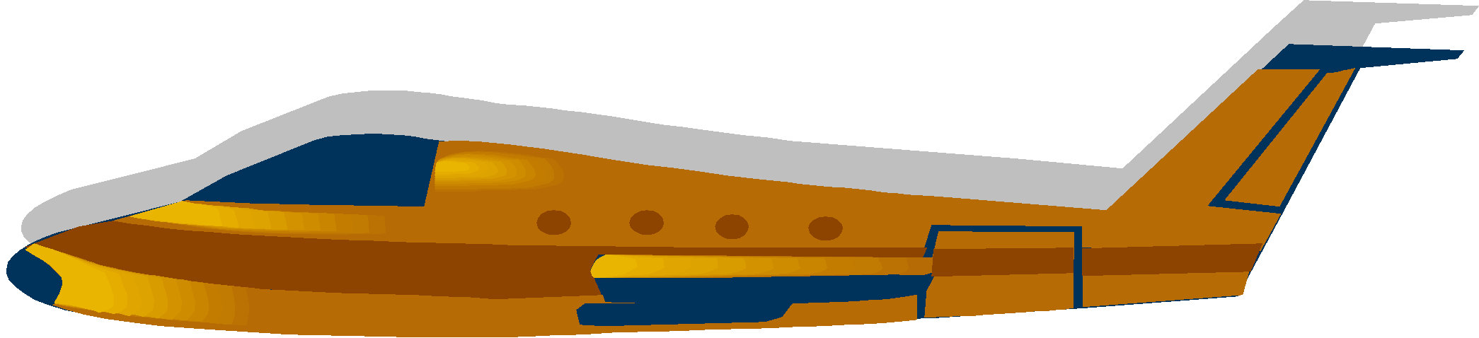
Topic A: Space, time and motion A.2 – Forces…
Solving problems involving forces and resultant force
EXAMPLE: A 1000-kg airplane is flying at a constant velocity of 125 m s⁻¹. Label and determine the value of the weight F_{g}, the lift F_{L}, the drag F_{D} and the thrust (applied force) F_{A} if the drag is 25000 N.
SOLUTION:
Since the velocity is constant, Newton’s first law applies. Thus ΣF_{x} = 0 and ΣF_{y} = 0.
F_{g} = mg = 1000(10) = 10000 N (down).
∙Since ΣF_{y} = 0, F_{L} - F_{g} = 0, so F_{L} = F_{g} = 10000 N (up).
∙ F_{D} = 25000 N tries to impede the aircraft (left).
∙Since ΣF_{x} = 0, F_{A} - F_{D} = 0, so F_{A} = F_{D} = 25000 N (right).
F_{L}
F_{D}
F_{A}
F_{g}
Notes:
© 2006 By Timothy K. Lund

Slide 31
Topic A: Space, time and motion A.2 – Forces…
a = F_{net} / m
Newton’s laws of motion – The second law
∙Newton reasoned: “If the sum of the forces is not zero, the velocity will change.”
∙Newton knew (as we also know) that a change in velocity is an acceleration.
∙So Newton then asked himself: “How is the sum of the forces related to the acceleration?”
∙Here is what Newton said: “The acceleration of an object is proportional to the net force acting on it, and inversely proportional to its mass.”
∙The bigger the force the bigger the acceleration, and the bigger the mass the smaller the acceleration.
F_{net} = ma
(or ΣF = ma )
Newton’s second law
Notes:
© 2006 By Timothy K. Lund

Slide 32
Topic A: Space, time and motion A.2 – Forces…
Newton’s laws of motion – The second law
∙Looking at the form ΣF = ma note that
if a = 0, then ΣF = 0.
∙But if a = 0, then v = CONST.
∙Thus Newton’s first law is just a special case of his second – namely, when the acceleration is zero.
F_{net} = ma
(or ΣF = ma )
Newton’s second law
FYI
∙The condition a = 0 is thus the condition for translational equilibrium, just as ΣF = 0 is.
∙Finally, if you take a physics course and you can’t use notes, memorize the more general formulas.
Notes:
© 2006 By Timothy K. Lund

Slide 33
Topic A: Space, time and motion A.2 – Forces…
Newton’s laws of motion – The second law
F_{net} = ma
(or ΣF = ma )
Newton’s second law
EXAMPLE: An object has a mass of 25 kg. A tension of 50 N and a friction force of 30 N are acting on it as shown. What is its acceleration?
SOLUTION:
The vertical forces F_{g} and F_{N} cancel out.
The net force is thus
F_{net} = F_{T} – F_{f} = 50 – 30 = 20 N (+x-dir).
From F_{net} = ma we get 20 = 25 a so that
a = 20 / 25 = 0.8 m s⁻² (+x-dir).
F_{N}
50 N
F_{T}
F_{f}
30 N
F_{g}
Notes:
© 2006 By Timothy K. Lund

Slide 34
Topic A: Space, time and motion A.2 – Forces…
Newton’s laws of motion – The second law
F_{net} = ma
(or ΣF = ma )
Newton’s second law
PRACTICE: Use F = ma to show that the formula for weight is correct.
SOLUTION:
F = ma.
But F is the weight F_{g}.
And a is the freefall acceleration g.
Thus F = ma becomes F_{g} = mg.
Notes:
© 2006 By Timothy K. Lund

Slide 35
Topic A: Space, time and motion A.2 – Forces…
Newton’s laws of motion – The second law
F_{net} = ma
(or ΣF = ma )
Newton’s second law
EXAMPLE: A 1000-kg airplane is flying in perfectly level flight. The drag F_{D} is 25000 N and the thrust (applied force) F_{A} is 40000 N. Find its acceleration.
SOLUTION:
Since the flight is level, ΣF_{y} = 0.
∙ΣF_{x} = F_{A} – F_{D} = 40000 – 25000 = 15000 N = F_{net}.
∙From F_{net} = ma we get 15000 = 1000a, or
a = 15000 / 1000 = 15 m s⁻².
F_{L}
F_{D}
F_{A}
F_{g}
Notes:
© 2006 By Timothy K. Lund

Slide 36
Topic A: Space, time and motion A.2 – Forces…
Solving problems involving forces and resultant force
EXAMPLE: A 25-kg object has exactly two forces F₁ = 40. N and F₂ = 30. N applied simultaneously to it. What is the object’s acceleration?
F₂
SOLUTION:
Resolve F₁ into its components:
Then F_{net,x} = 36 N and
F_{net,y} = 17 + 30 = 47 N. Then
F_{net}² = F_{net,x}² + F_{net,y}²
F_{net}² = 36² + 47² and F_{net} = 59 N.
Then from F_{net} = ma we get 59 = 25a, or
a = 59 / 25 = 2.4 m s⁻².
30 N
F₁
40 N
40 sin 25°
17 N
25°
36 N
40 cos 25°
Notes:
© 2006 By Timothy K. Lund

Slide 37
Topic A: Space, time and motion A.2 – Forces…
Solving problems involving forces and resultant force
EXAMPLE: A 25-kg object resting on a frictionless incline is released, as shown. What is its acceleration?
SOLUTION:
∙Begin with a FBD.
∙Break down the weight into its components.
∙Since F_{N} and mg cos 30°are perpendicular to the path of the crate they do NOT contribute to its acceleration.
∙Thus F_{net} = ma
mg sin 30° = ma
a = 10 sin 30° = 5.0 m s⁻².
F_{N}
6.0 m
30°
60°
mg cos 30°
30°
mg sin 30°
F_{g} = mg
Notes:
© 2006 By Timothy K. Lund

Slide 38
Topic A: Space, time and motion A.2 – Forces…
Solving problems involving forces and resultant force
u = 0
EXAMPLE: A 25-kg object resting on a frictionless incline is released, as shown. What is its speed at the bottom?
SOLUTION:
∙We found that its acceleration is 5.0 m s⁻².
∙We will use v ² = u ² + 2as to find v, so we need s.
∙We have opposite and we want hypotenuse s so from trigonometry, we use sin θ = opp / hyp.
∙Thus s = hyp = opp / sin θ = 6 / sin 30° = 12 m and
v² = u² + 2as = 0² + 2(5)(12) = 120
so that v = 11 m s⁻¹.
a = 5 m s⁻²
6.0 m
s
v = ?
30°
Notes:
© 2006 By Timothy K. Lund

Slide 39

Topic A: Space, time and motion A.2 – Forces…
Solving problems involving forces and resultant force
EXAMPLE: A 100. N crate is to be dragged across the floor by an applied force F_{A} = 60 N, as shown. The coefficients of static and dynamic friction are 0.75 and 0.60, respectively. What is the acceleration of the crate?
SOLUTION:
∙Static friction will oppose the applied force until it is overcome.
y
F_{N}
F_{A}
F_{f}
30°
x
a
F_{g}
FBD, crate
F_{A}
FYI ∙Since friction is proportional to the normal force, be aware of problems where an applied force changes the normal force.
F_{N}
30°
F_{f}
a
F_{g}
Notes:
© 2006 By Timothy K. Lund

Slide 40
Topic A: Space, time and motion A.2 – Forces…
Solving problems involving forces and resultant force
SOLUTION:
∙Determine if the crate even moves.
∙Thus, find the maximum value of the static friction, and compare it to the horizontal applied force:
y
F_{N}
F_{A}
F_{f}
30°
x
a
F_{g}
F_{H} = F cos 30°
= 60 cos 30°
= 51.96 N.
∙The maximum static friction force is
FBD, crate
F_{s,max} = μ_{s} R
= 0.75R
∙The normal force is found from...
R + F sin 30° - mg = 0
R + 60 sin 30° - 100 = 0
R = 70
F_{s,max} = 0.75(70) = 52.5 N
∙Thus the crate will not even begin to move!
Notes:
© 2006 By Timothy K. Lund

Slide 41
Topic A: Space, time and motion A.2 – Forces…
Solving problems involving forces and resultant force
EXAMPLE: If someone gives the crate a small push (of how much?) it will “break” loose. What will its acceleration be then?
SOLUTION:
y
F_{N}
F_{A}
F_{f}
30°
x
∙The horizontal applied force is still
a
F_{g}
F_{A} cos 30°
= 60 cos 30°
= 51.96 N.
∙The dynamic friction force is
FBD, crate
F_{f} = μ_{d} F_{N}
= 0.60F_{N}.
∙The reaction force is still F_{N} = 70. N.
∙Thus F_{f} = 0.60(70) = 42 N.
∙The crate will accelerate.
F_{A} cos 30° - F_{f} = ma
51.96 - 42 = (100 / 10)a
a = 0.996 m/s²
Notes:
© 2006 By Timothy K. Lund

Slide 42
Topic A: Space, time and motion A.2 – Forces…
Newton’s laws of motion – The third law
∙In words “For every action force there is an equal and opposite reaction force.”
∙In symbols
∙In the big picture, if every force in the universe has a reaction force that is equal and opposite, the sum of all the forces in the whole universe is zero!
F_{AB} = ⁻F_{BA}
Newton’s third law
F_{AB} is the force on body A by body B.
F_{BA} is the force on body B by body A.
FYI ∙So why are there accelerations all around us?
∙Because each force of the action-reaction pair acts on a different mass.
Notes:
© 2006 By Timothy K. Lund

Slide 43

Topic A: Space, time and motion A.2 – Forces…
Identifying force pairs in context of Newton’s third law
EXAMPLE: When you push on a door with 10 N, the door pushes you back with exactly the same 10 N, but in the opposite direction. Why does the door move, and not you?
SOLUTION: ∙Even though the forces are equal and opposite, they are acting on different bodies.
the door’s reaction
your
action
F_{BA}
F_{AB}
B
A
A
Each body acts in response only to the force acting on it.
The door CAN’T resist F_{AB}, but you CAN resist F_{BA}.
Notes:
© 2006 By Timothy K. Lund

Slide 44

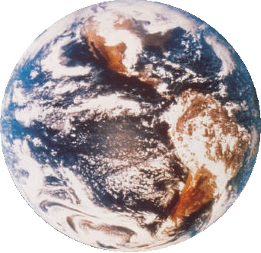
Topic A: Space, time and motion A.2 – Forces…
F_{BE}
Identifying force pairs in context of Newton’s third law
N_{BT}
EXAMPLE:
Consider a baseball resting on a tabletop. Discuss each of the forces acting on the baseball, and the associated reaction force.
SOLUTION:
Acting on the ball is its weight F_{BE} prior to contact with the table.
N_{TB}
F_{EB}
∙Note that F_{BE} (the weight force) and N_{BT} (the normal force) are acting on the ball.
N_{TB} (the normal force) acts on the table.
F_{EB} (the weight force) acts on the earth.
Notes:
© 2006 By Timothy K. Lund

Slide 45
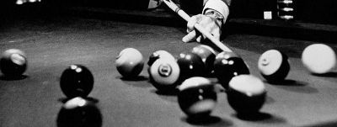
Topic A: Space, time and motion A.2 – Forces…
Identifying force pairs in context of Newton’s third law
∙We define a system as a collection of more than one body, mutually interacting with each other.
EXAMPLE: Three billiard balls interacting on a pool table constitute a system.
∙The action-reaction force pairs between the balls are called internal forces.
∙For any system, all internal forces always cancel!
Notes:
© 2006 By Timothy K. Lund

Slide 46
Topic A: Space, time and motion A.2 – Forces…
Identifying force pairs in context of Newton’s third law
∙We define a system as a collection of more than one body, mutually interacting with each other.
EXAMPLE: Three colliding billiard balls constitute a system. Discuss all of the internal forces.
∙The internal force pairs only exist while the balls are in contact with one another.
∙Note that a blue force and a red force act on the white ball. The white ball responds only to those two forces.
∙Note that a single white force acts on the red ball. The red ball responds only to that single force.
∙Note that a single white force acts on the blue ball. The blue ball responds only to that single force.
Notes:
© 2006 By Timothy K. Lund

Slide 47
Topic A: Space, time and motion A.2 – Forces…
Identifying force pairs in context of Newton’s third law
∙We define a system as a collection of more than one body, mutually interacting with each other.
EXAMPLE: Three billiard balls interacting on a pool table constitute a system. Describe the external forces.
∙External forces are the forces that the balls feel from external origins (not each other).
∙For billiard balls, these forces are the balls’ weights, their reaction forces, the cushion forces, and the cue stick forces.
Notes:
© 2006 By Timothy K. Lund

Slide 48
Floating and Sinking
Why does an object sink in water etc.?

Slide 49
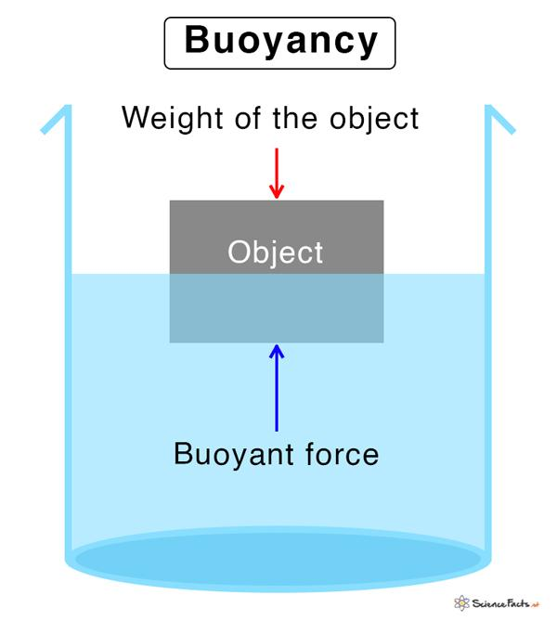
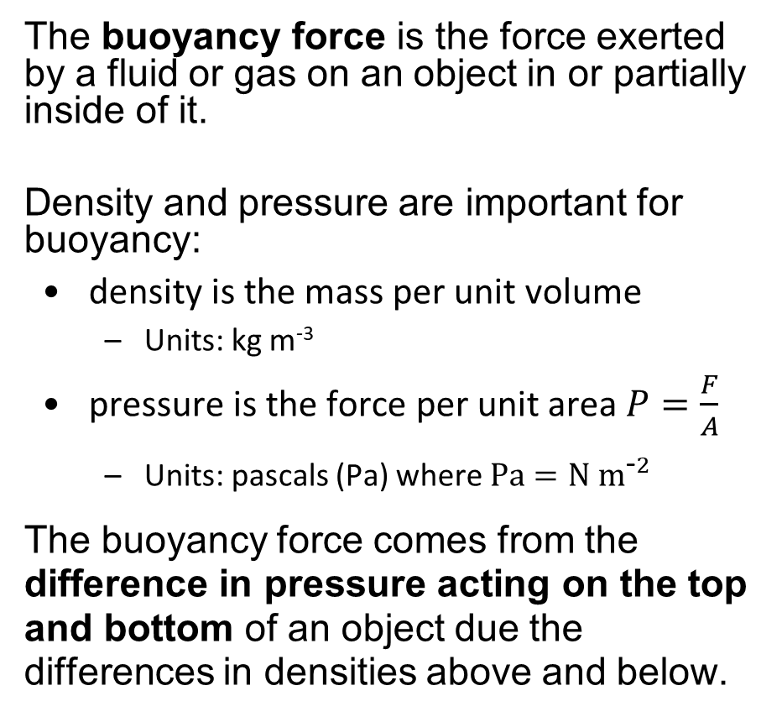
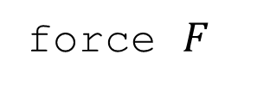
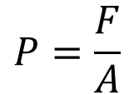
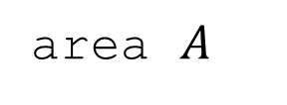
Buoyancy Force

Slide 50
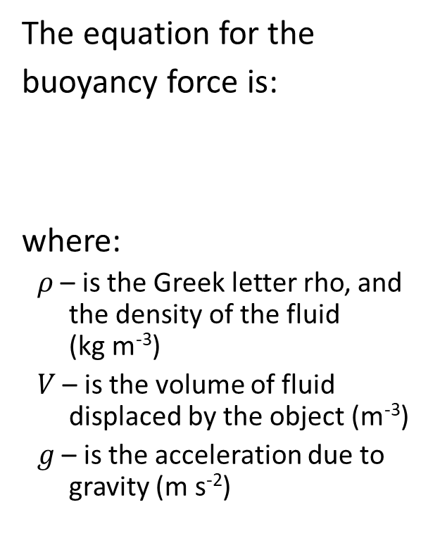
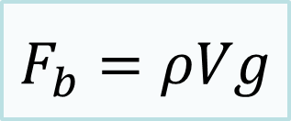

Buoyancy Force
Three potential situations:
neutral buoyancy: equal densities
sinking: when (overall average) density is greater than fluid (net force down)
float: (overall average) density is less than fluid, volume displaced is volume below the fluid’s surface

Slide 51
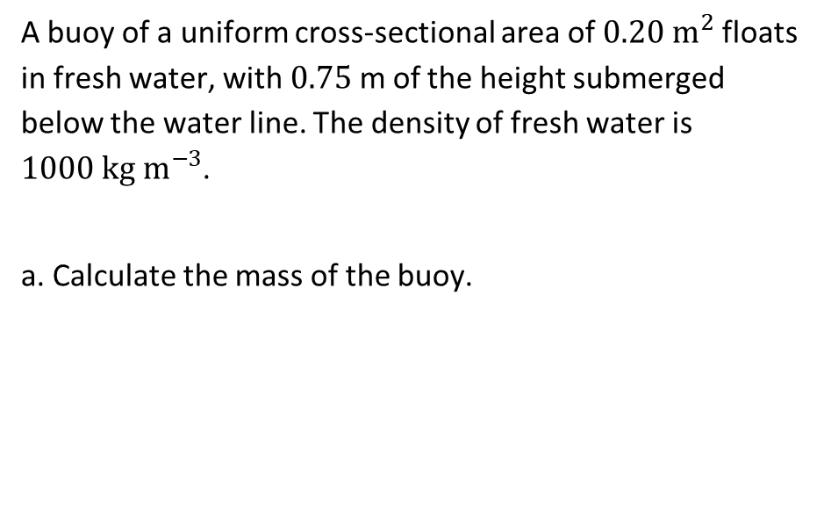
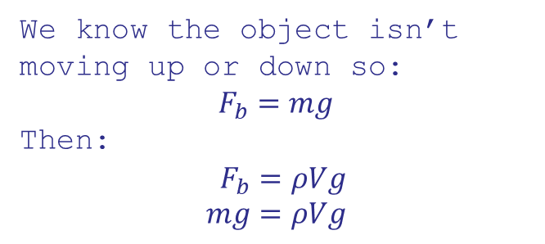
Buoyancy Force
0.75 cm
b. The buoy is now placed in seawater of a greater density than fresh water. Explain the change, if any, in the submerged heigh of the buoy.
The buoy will float higher because the higher density of water means less needs to be displaced to equal the mass of the buoy.

Slide 52
AIR RESISTANCE AND DRAG

Slide 53
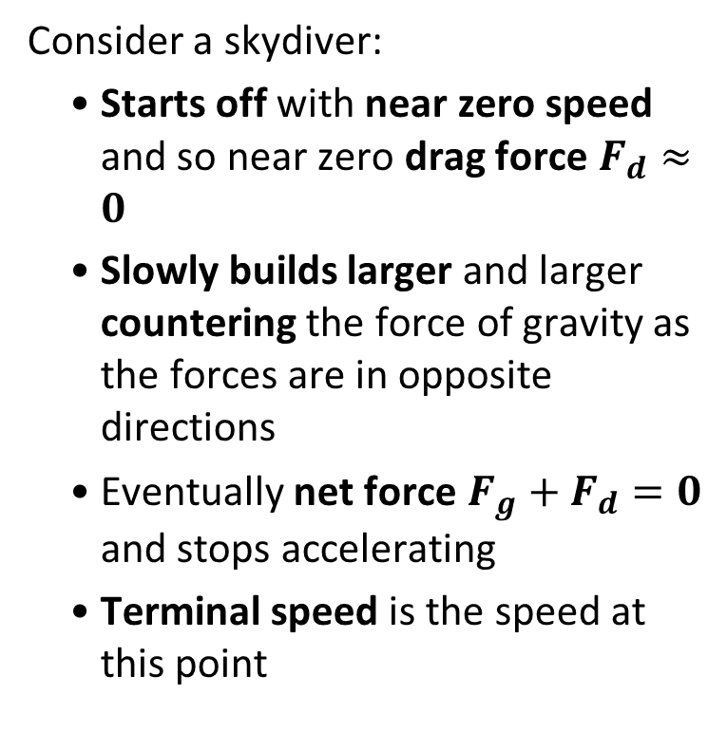





Air Resistance
drag force
drag force
drag force
Terminal speed is the maximum speed at which an object can fall at in a given fluid

Slide 54
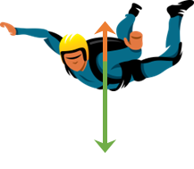
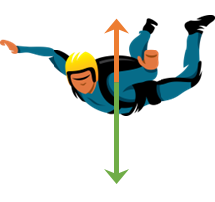





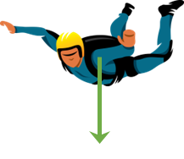
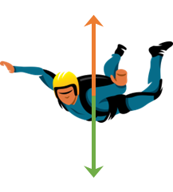

Air Resistance
terminal
speed
drag force
vertical speed
drag force
time
drag force
drag force
time

Slide 55
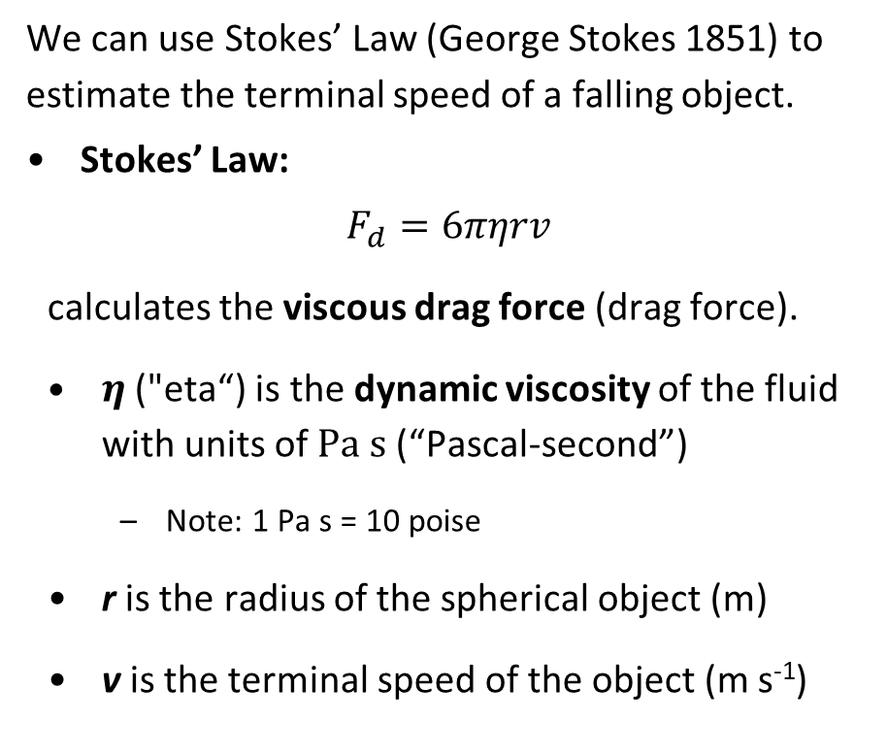
Stokes’ Law
terminal
speed
vertical speed
time
Thinking of forces, what condition can we write when an object is moving at terminal speed?

Slide 56
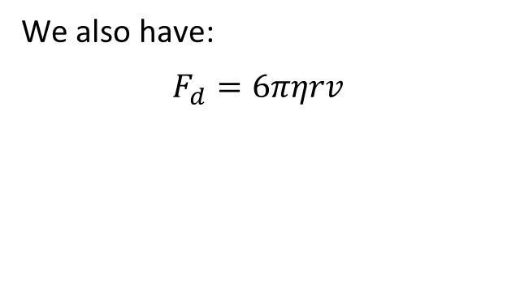

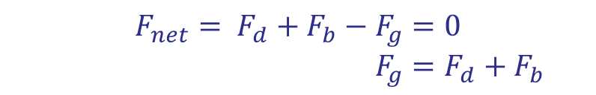

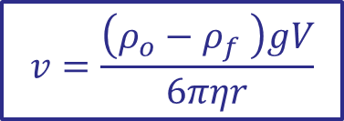
Stokes’ Law and Terminal Speed
Thinking of forces, what condition can we write when an object is moving at terminal speed?
At terminal speed, its speed is constant, so the net force is zero:
Note: This is NOT in the Data Booklet

Slide 57
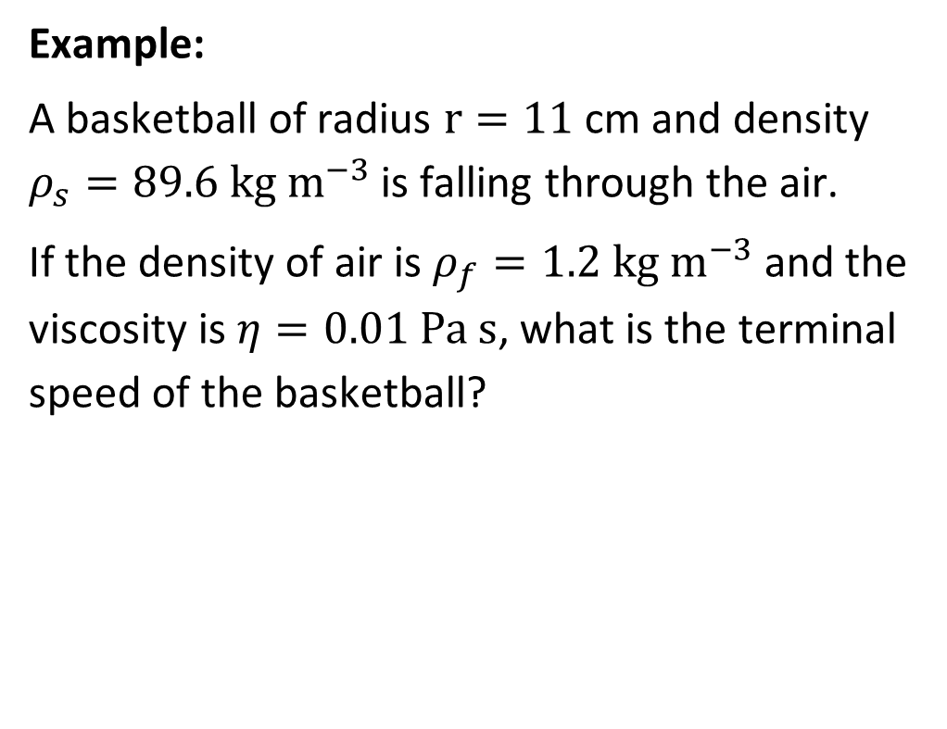

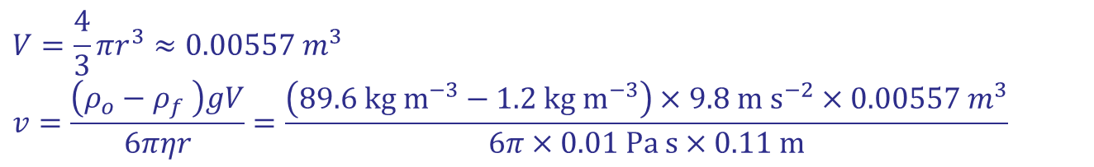

Stokes’ Law and Terminal Speed

